Slide 1
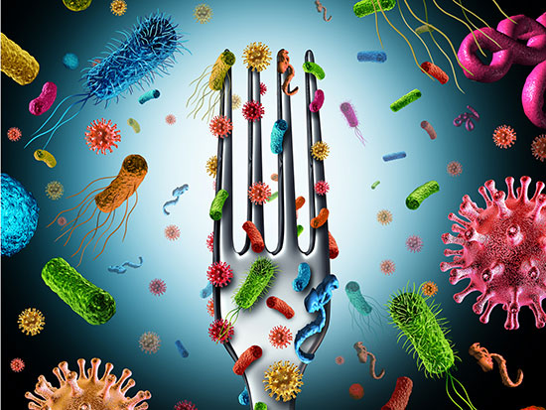
Foodborne Illness

Slide 2
Top Ten Germiest Places at Home
#1 Dish/Sponge Rags
#2 Kitchen Sinks
#3 Toothbrush Holders
#4 Pet Bowls
#5 Coffee Makers
#6 Faucet Handles
#7 Pet Toys
#8 Kitchen Counters
#9 Stove Knobs
#10 Cutting Boards
See statistics about each germy place:
Yuck! Top 10 germiest spots in your home - Photo 1 (cbsnews.com)

Slide 3
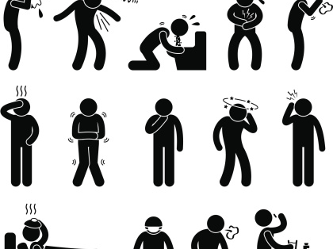
OVERVIEW

Slide 4
Salmonella
Bacteria
Found in raw or undercooked foods such as poultry, eggs, meat, and unpasteurized milk
Stomach pain, diarrhea, nausea, chills, fever, and headache
Young children and elderly more at risk

Slide 5
Salmonella

Slide 6
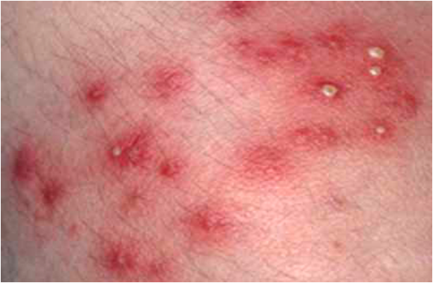
Staph
Bacteria
Found on human skin, in nose, and in throat
Nausea, vomiting, diarrhea
Spread skin-to-skin

Slide 7
Staph

Slide 8
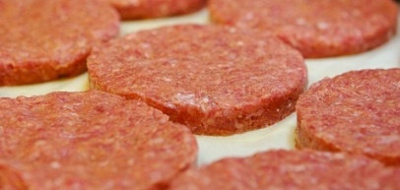
E. Coli
Bacteria
Found in contaminated water, raw or rare ground beef, and unpasteurized milk
Severe abdominal cramps, diarrhea, nausea, vomiting, low-grade fever
Often requires hospitalization
Could lead to urinary tract infection and kidney failure.

Slide 9
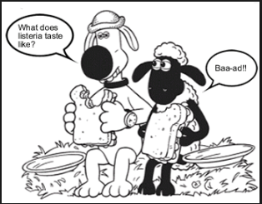
Listeriosis
Bacteria
Can live in the environment; soil, water, poultry, cattle, raw milk, processed meats
Rare but potentially fatal. Fever, chills, headache, abdominal pain, and diarrhea
Can cause miscarriages and stillbirths

Slide 10
Listeriosis

Slide 11
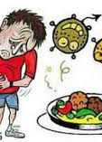
Clostridium perfringens
Bacteria
Grows where there is little or no oxygen; poor ventilation
Also called the “Cafeteria Germ”
Strikes food that is left for long periods of time at room temperature
Diarrhea and gas pains.

Slide 12
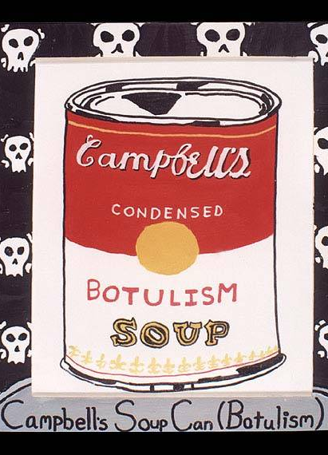
Botulism
Bacteria
Grows where there is little or no oxygen; poor ventilation
Associated with improperly processed canned food
Affects the nervous system, can be fatal
Symptoms include double vision, droopy eyelids, trouble speaking, swallowing and difficulty breathing

Slide 13
Botulism

